Slide 1

CAPSTONE - 3
Contextual Text Extraction from PDF files using Machine Learning Practices

Slide 2

TEAM-8
S. Vignesh - 21R11A0597
G. Sandhya rani -21R11A0569
R. Dhathri - 21R11A0545
G. Sri Hasini - 21R11A0518
A. Pooja - 21R11A0501
PBSN. Sriya - 21R11A0595
N. Sai Charan - 21R11A0588
MD. Akbar ali - 21R11A0586

Slide 3

Contents
01
02
03
04
Introduction
Problem Statement
Objectives
Methodology
05
06
07
08
Literature review
Different types of approaches
Final implementation
Conclusion

Slide 4

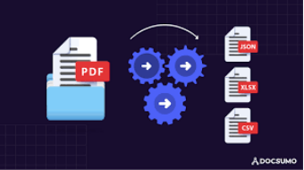
INTRODUCTION
In today's digital era, PDF documents are ubiquitous across various domains, posing challenges for efficient data extraction. Manual methods are time-consuming and error-prone, leading to inconsistent results. To address this, a capstone project leverages Machine Learning (ML) techniques for automated extraction of key information from PDFs. This includes extracting data like Director names, types, and DIN from diverse documents like bank statements or legal forms. By harnessing ML-based text extraction, the project aims to streamline workflows, improve productivity, and contribute to automated data extraction advancements, meeting the growing demand for efficient PDF data handling.

Slide 5

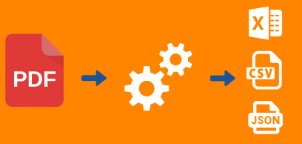
Problem
The project aims to tackle the inefficiency and inconsistency of manually extracting information from PDF documents, focusing on key data elements like Director names, types, and DIN. This involves developing an automated solution using Machine Learning (ML) techniques, known for their accuracy in text recognition and extraction from PDFs. The solution targets various PDF layouts and structures to ensure robustness and reliability across different document formats, addressing the challenges of manual extraction and unstructured data within PDFs.
STATEMENT

Slide 6
OBJECTIVES
Objective 2
Create a solution capable of handling the variability in PDF document layouts and structures, ensuring adaptability and versatility across different document formats and styles.
Objective 1
Design and implement a robust solution leveraging Machine Learning (ML) techniques to automate the extraction of key information from PDF documents, including the Name of the Director, Director type (Independent/Executive), and DIN (Director Identification Number).
Objective 3
Ensure that the extracted information is accurate and consistent across various PDF documents, minimizing errors and discrepancies in the extracted data.

Slide 7


METHODOLOGY
1 .Data Source
The data sources are the pdf files given. The information in the pdf file consist of Directors Details.
equitas.pdf ( 329 KB)
Triveni2.pdf ( 872 KB )
varun.pdf ( 3 MB )
PolyPlex.pdf ( 471 KB )
Triveni1.pdf ( 9 MB )

Slide 8
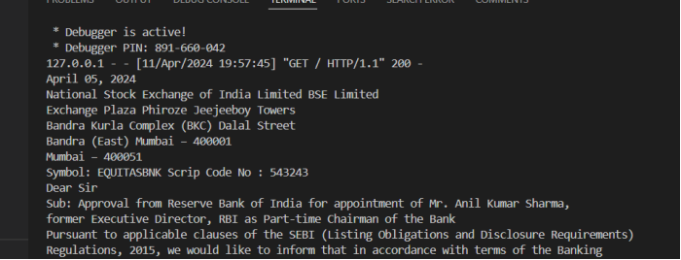
METHODOLOGY
2. EDA(exploration data analysis)
The user extracted data from the "equitas.pdf" file using pdfplumber, finding information about the approval from the Reserve Bank of India for Mr. Anil Kumar Sharma's appointment as Part-time Chairman of the Bank. The document also includes details about the National Stock Exchange of India Limited, BSE Limited, their addresses, and the bank's symbol and scrip code. Additionally, the document's structure involves various objects such as Contents, CropBox, Group, MediaBox, Parent, Resources, ExtGState, Font, ProcSet, XObject, Rotate, Tabs, and Type, providing detailed insights into the page's structure and content.

Slide 9
METHODOLOGY
3. Efficent Director Details Extraction from PDFs
This Python script utilizes the pdfplumber library to extract text from PDF files. It then employs SpaCy, a powerful natural language processing library, for named entity recognition (NER) to identify persons mentioned in the text. For each recognized director, the script determines their role type (Independent or Executive) and extracts associated Director Identification Numbers (DINs) using regular expressions. These DINs are strategically located in proximity to the director's name within the text. Finally, the script presents the extracted director names alongside their roles and DINs, streamlining the extraction of critical corporate governance data from PDF documents.

Slide 10
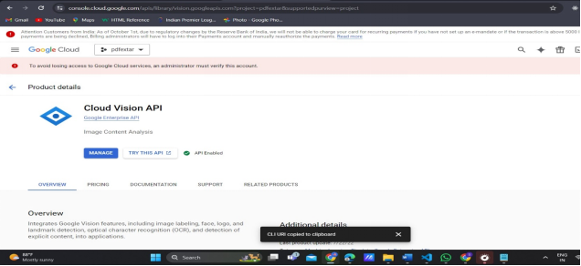
6. DIFFERENT TYPES OF APPROACHES FOR THE SOLUTION
Using cloud vison API

Slide 11
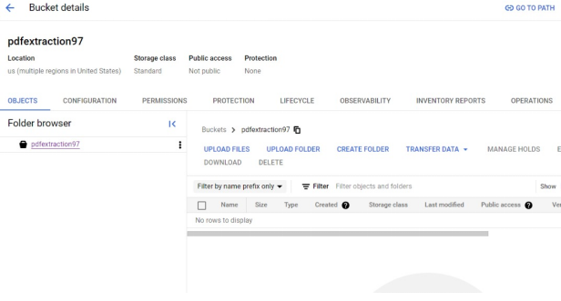
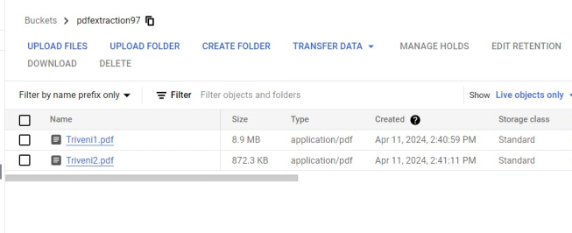
Create The storage Bucket to store the cloud vision API
Store all the given test pdf files in Bucket using upload files from the local storage system

Slide 12
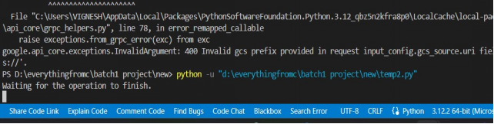
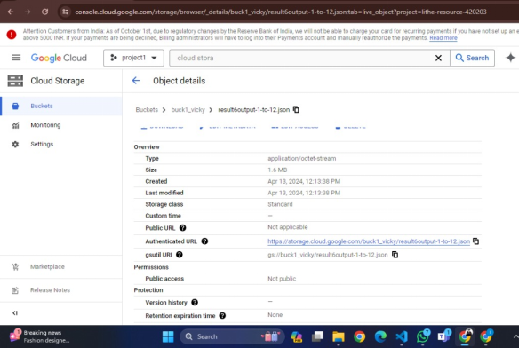
now the uploaded file convert the pdf file information into json format

Slide 13
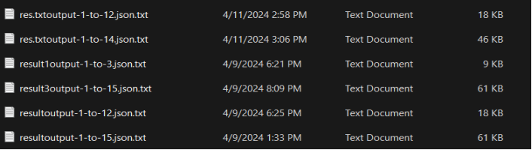
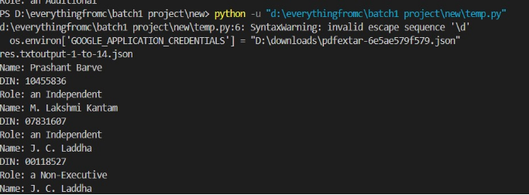
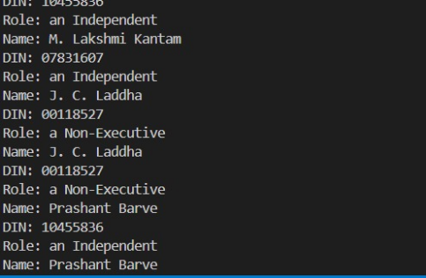
After converting into json format conver the json format to txt format for checking the regular expression matching and finds all the pattern matches and return or print into console cloud vision API is used to conver the picture into text
The output when pattern matches

Slide 14
2.USING PDFPLUMBER WITH FLASK API
The implementation of the web application using Flask involves the utilization of several libraries, including re, spacy, PyPDF2, pdfplumber, NLP libraries, and ML techniques. The patterns for retrieving 'Director Name', 'DIN', and 'status' are as follows:
director_patterns = r"\. (.+?) \(DIN: (\d+)\),\s+(.*?)\s+as\s+(.*?)(?=;|\n|$)"
director_pattern = r"(Mr\.|Mrs\.|Ms\.|Dr\.)\s+([A-Za-z]{2,})"
din_pattern = r"DIN:\s(\d+)"
director_patterns = r"\. (.+?) \(DIN: (\d+)\),\s+(.*?)\s+as\s+(.*?)(?=;|\n|$)"
director_pattern = r"(Mr\.|Mrs\.|Ms\.|Dr\.)\s+([A-Za-z]{2,})"

Slide 15
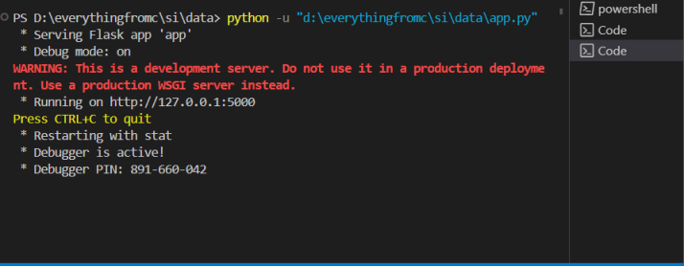
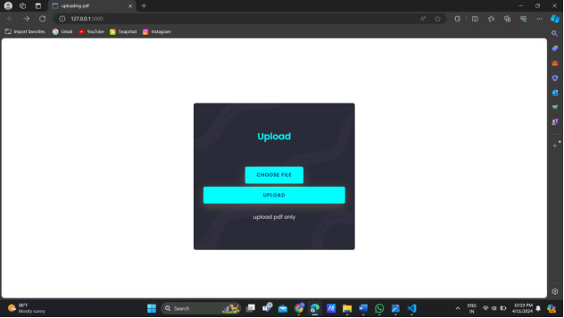
FINAL IMPLEMENTATION

Slide 16
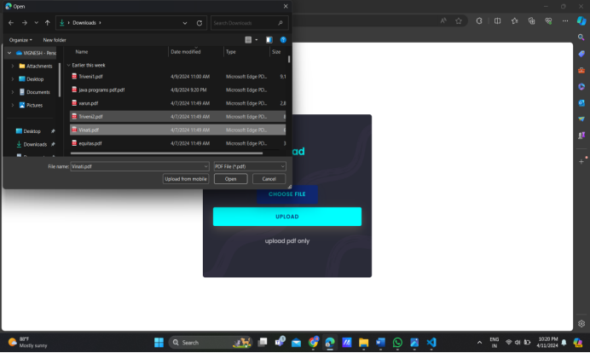

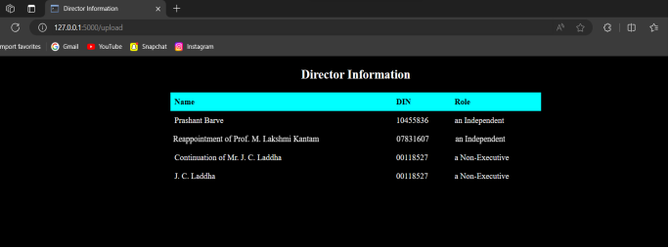

Slide 17
CONCLUSION
In our study showcases the efficency of machine learning in PDF data extraction, showcasing its capacity to revolutionize data retrieval processes. By harnessing ML techniques, we have streamlined operations, ensuring accuracy, and consistency in extracted information. This approach not only saves time but also enhances data quality, minimizing errors inherent in manual extraction methods. The automation facilitated by ML algorithms promises to significantly improve document accessibility for diverse stakeholders across industries. This project underscores the transformative potential of technology in optimizing workflows and unlocking valuable insights from PDF documents. Moving forward, further refinement and integration of ML-driven solutions hold promise for greater efficiency and innovation in data extraction endeavors. Through this endeavor, we contribute to the advancement of automated data processing, empowering organizations and individuals with enhanced capabilities for information retrieval and analysis.

Slide 18
THANK
YOU

